Slide 1
Dealing with
Verification Data Overload
Lan Xia & Renfei Wang
Runtime Technologies
June 2019

Slide 2
Agenda
Dealing with Verification Data Overload
The Scope
Test Framework (TestKitGen)
Jenkins builds
Test Result Summary Service (TRSS)
Data Refinery Experiments
Plans Forward

Slide 3



The Scope
Dealing with Verification Data Overload
Ensuring Free and Verified Java™ for the Community
Projects: Eclipse OMR, Eclipse OpenJ9, AdoptOpenJDK
6+ Jenkins servers
AdoptOpenJDK
Notes:
Jenkins is an open source automation server. Jenkins helps to automate the software development process, with continuous integration.

Slide 4
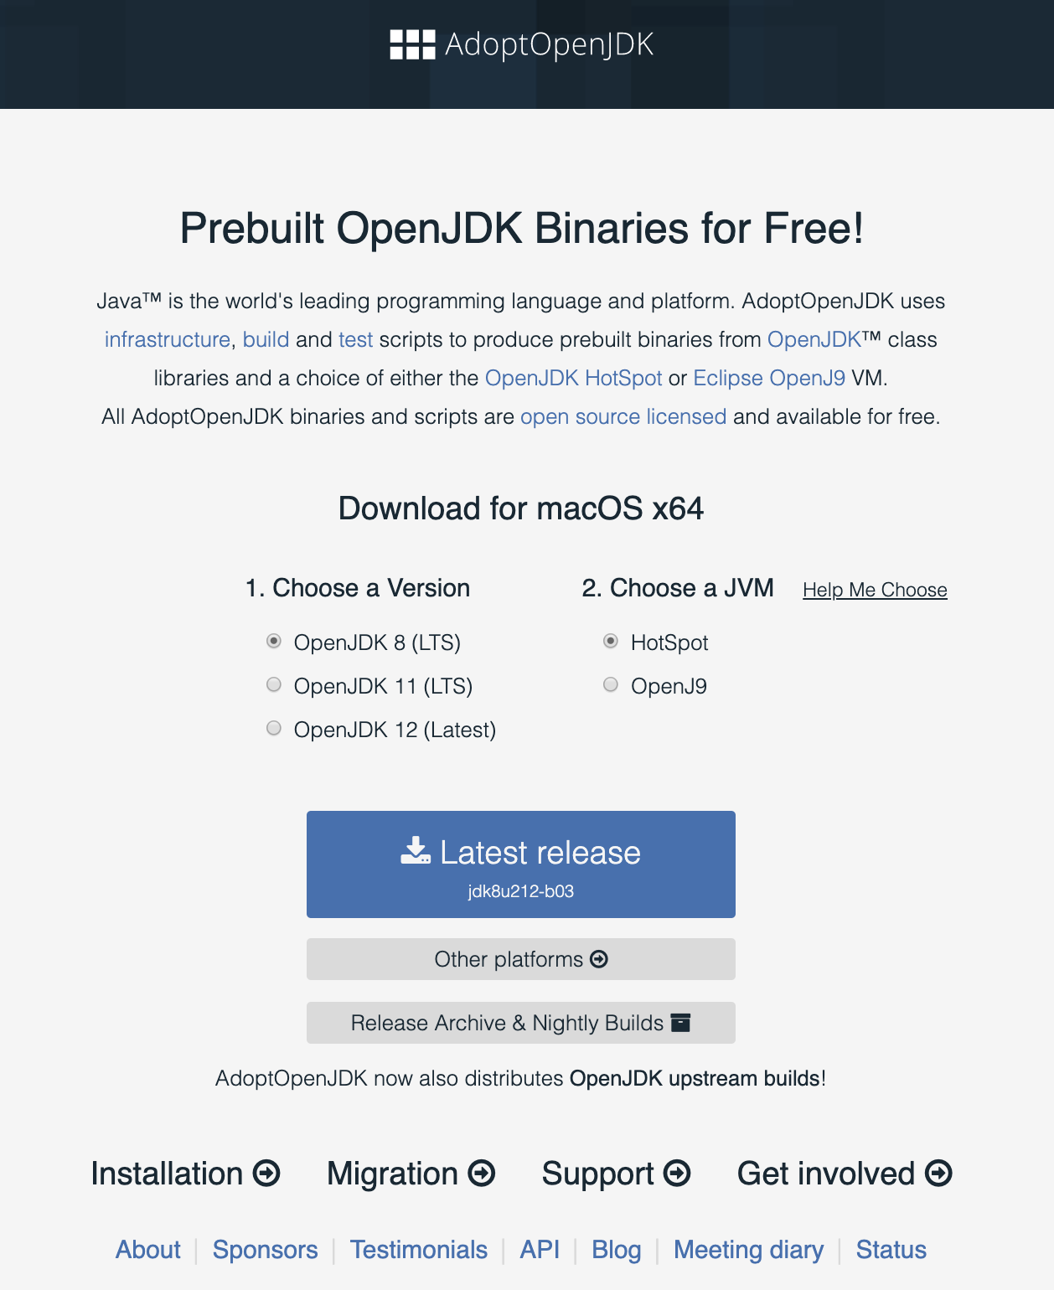
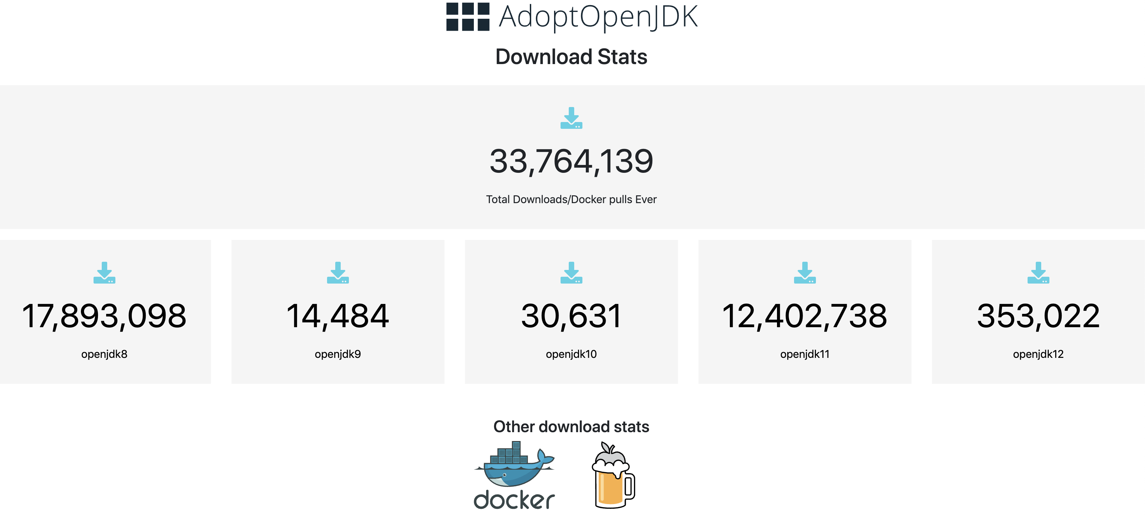
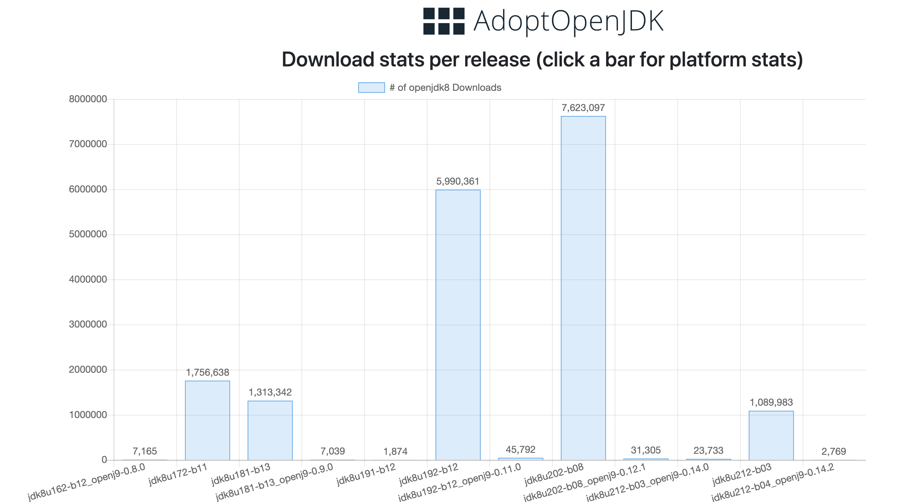
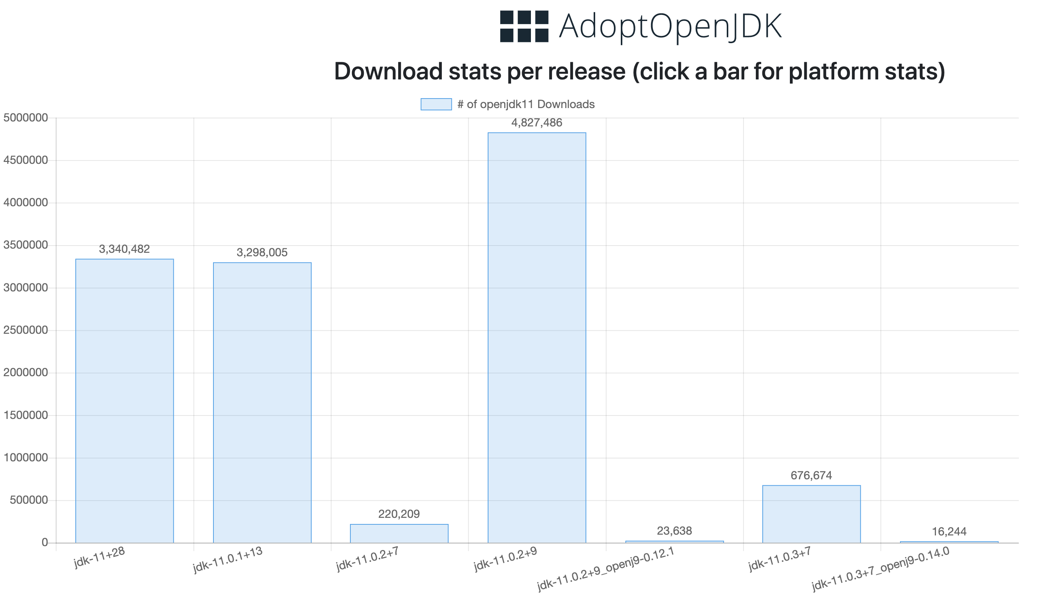
Dealing with Verification Data Overload

Slide 5
Degrees of Freedom
Dealing with Verification Data Overload
OpenJ9
Hotspot
SAP
Corretto
RI
JDK Implementations
58 impl_platform
osx
Platforms
osx
aix
win
xlinux
plinux
aarch
6 versions
8
9
10
11
12
13
+
JDK Versions
Plus PR builds, promotion builds and personal builds
openjdk
functional
perf
system
external
Test Categories
250000 tests
87,000,000 Tests
Impl_platform x testLevels x testGroups x versions
58 x 2 x 3 x 6 x 10M = 20G+ test output per nightly build

Slide 6
Gather Great Tests
Dealing with Verification Data Overload
functional
openjdk
system
external
perf
20,000 tests
2900 tests
6600 per release
~25,000 tests
8+ apps, 3 microprofile TCKs
~50,000 container tests
6+ benchmarks (micros & full suites)

Slide 7
Gather Great Tests
Dealing with Verification Data Overload
functional
openjdk
system
external
perf
testNG, cmdlinetester
Jtreg, testNG
STF
junit & others
Assorted benchmarks
$(JAVA_BIN)/java -cp GeneralTest.jar org.testng.TestNG -d $(REPORTDIR) testng.xml -testnames floatSanityTests -groups sanity
perl stf.pl -test-root=openjdk-systemtest_root -systemtest-prereqs=systemtest_prereqs -java-args=-Xjit -results-root=reportdir -test=ConcurrentLoadTest
$(JAVA_BIN)/java -Xmx512m -jar jtreg.jar -vmoptions:"-Xmx512m" -w work -r report -jdk:$(JDK_HOME) -exclude:ProblemList.txt jdk_math
sbt "partest $(TEST_SUITE)”
${ANT_HOME}/bin/ant -Divy_install_path=${ANT_HOME}/lib -lib ${ANT_HOME}/lib -f ${LUCENE_SOLR_HOME}/lucene-solr/build.xml -Duser.home=${LUCENE_SOLR_HOME} -Dcommon.dir=${LUCENE_SOLR_HOME}/lucene-solr/lucene test
$(JAVA_BIN)/java -DBumbleBench.listOptions -jar BumbleBench.jar [Benchmark name]
Notes:
- test frameworks are different
- no summary page

Slide 8
AdoptOpenJDK Quality Assurance (AQA)
Dealing with Verification Data Overload
“Make quality certain to happen”
Testing a wide criteria representing actual business requirements to identify binaries ready for production usage
Today Roadmap
Functional correctness Security
OpenJDK regression (open) Passes known vulnerability tests
Oracle JCK (closed) Functional correctness
OpenJDK regression
Builder-specific testing (unknown) Eclipse functional Application & framework tests
Performance
Published metrics
Achieves minimum throughput scores
Scalability & durability
Load & stress testing

Slide 9
AQA Manifesto
Dealing with Verification Data Overload
open & transparent
diverse & robust set of test suites
evolution alongside implementations
continual investment
process to modify
codecov & other metrics
comparative analysis
portable
tag & publish
Notes:
- Test source open, executed in the open, results openly available
- Cover different test categories (functional/regression, security, performance, scalability, load/stress), implementations, versions, platforms
- Evolution:
- refine automation and tools
- remove friction and reduce the process
- review existing/new tests on regular basis
- community awareness of addition/modification/deletion
- codecov, heatmap and bug prediction
- Easily run on local and Jenkins
- Audit trail

Slide 10
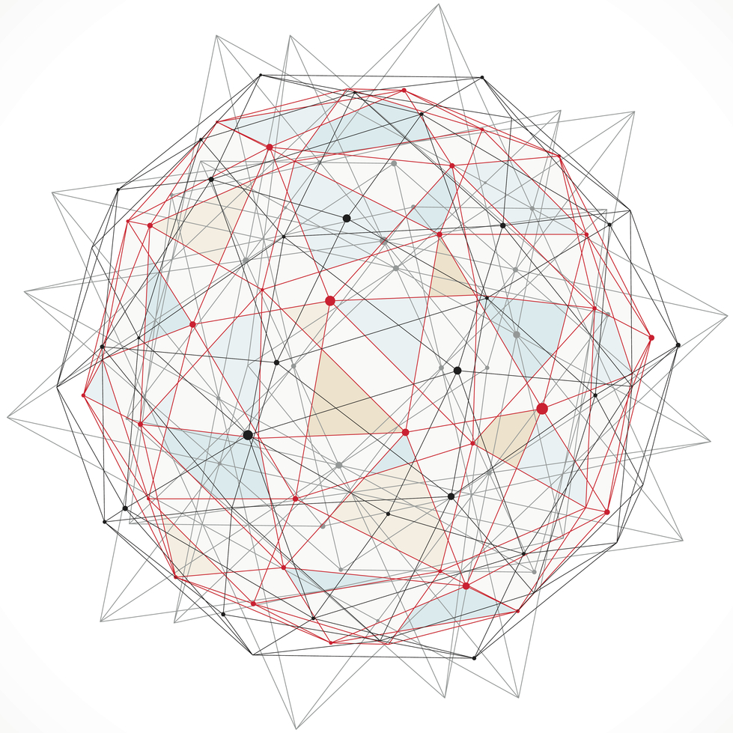
Innovate and Collaborate
Dealing with Verification Data Overload
Reactive systems
Latitude
Flexible
Common
Standardized
Simple
Notes:
We need a reactive system which works well in a changing world.
latitude to cover tests that may use significant different test frameworks
flexible to specify and test against different requirements
a common way to easily add, group, exclude and execute tests
test results to have same look & feel
Simple to be integrated with any build system

Slide 11
Granularity
Dealing with Verification Data Overload
Specific Testcases/groups
Different levels
Different versions
Different implementations
Different iterations
Different features
With/Without native test image
…
functional/system/openjdk/perf/external
sanity/extended/special
8/11/12…
openj9/hotspot/sap
1/2/n…
AOT/JITAAS
Notes:
Slice and dice
Different levels of granularity

Slide 12
Consolidate and Curate
Dealing with Verification Data Overload
functional
openjdk
system
external
perf
testNG, cmdlinetester
Jtreg, testNG
STF
junit & others
Assorted benchmarks
TestKitGen
make _functional
make _openjdk
make _system
make _external
make _perf
Notes:
Group, categorize, tag

Slide 13
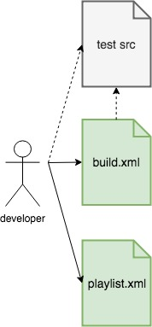
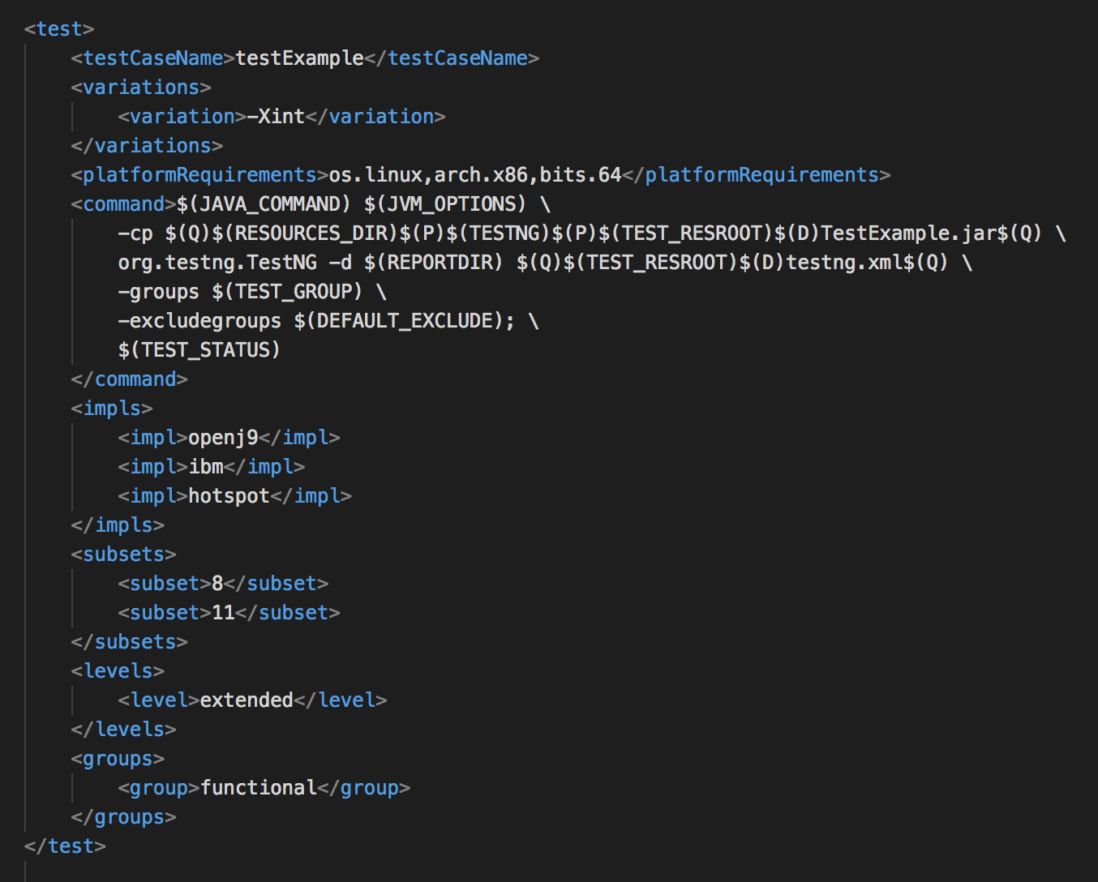
Test Framework (TestKitGen)
Dealing with Verification Data Overload

Slide 14
Grouping & Granularity
Dealing with Verification Data Overload
group=openjdk
levels=sanity.openjdk, extended.openjdk, special.openjdk
targets=tests in playlist file
jdk_awt, jdk_math, jdk_lang, etc.
jdk_custom=CUSTOM_TARGET env var
set to individual directories or classes
openjdk
sanity.openjdk
jdk_math
Java/math/BigDecimal/NegateTests.java

Slide 15
AdoptOpenJDK CI Pipeline
Dealing with Verification Data Overload
Test
Run in parallel
openjdk
functional
Build
system
Deploy
perf
external

Slide 16
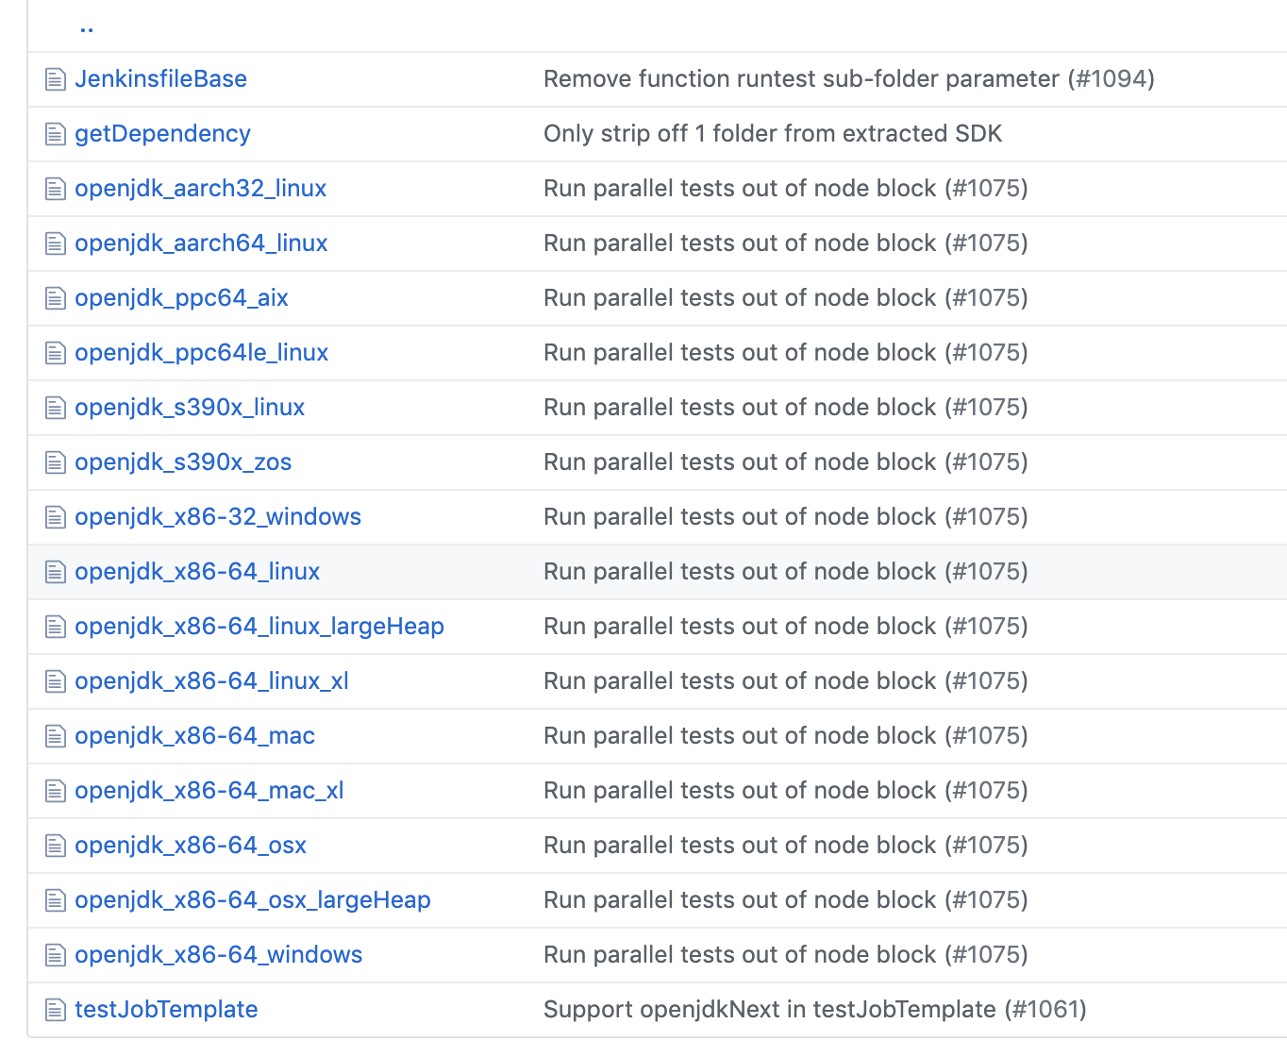
Jenkins scripts for testing
Dealing with Verification Data Overload
Repo: https://github.com/AdoptOpenJDK/openjdk-tests
One script (JenkinsfileBase) for all test builds:
Nightly/release
Pull Request
Promotion
Personal/Grinder

Slide 17
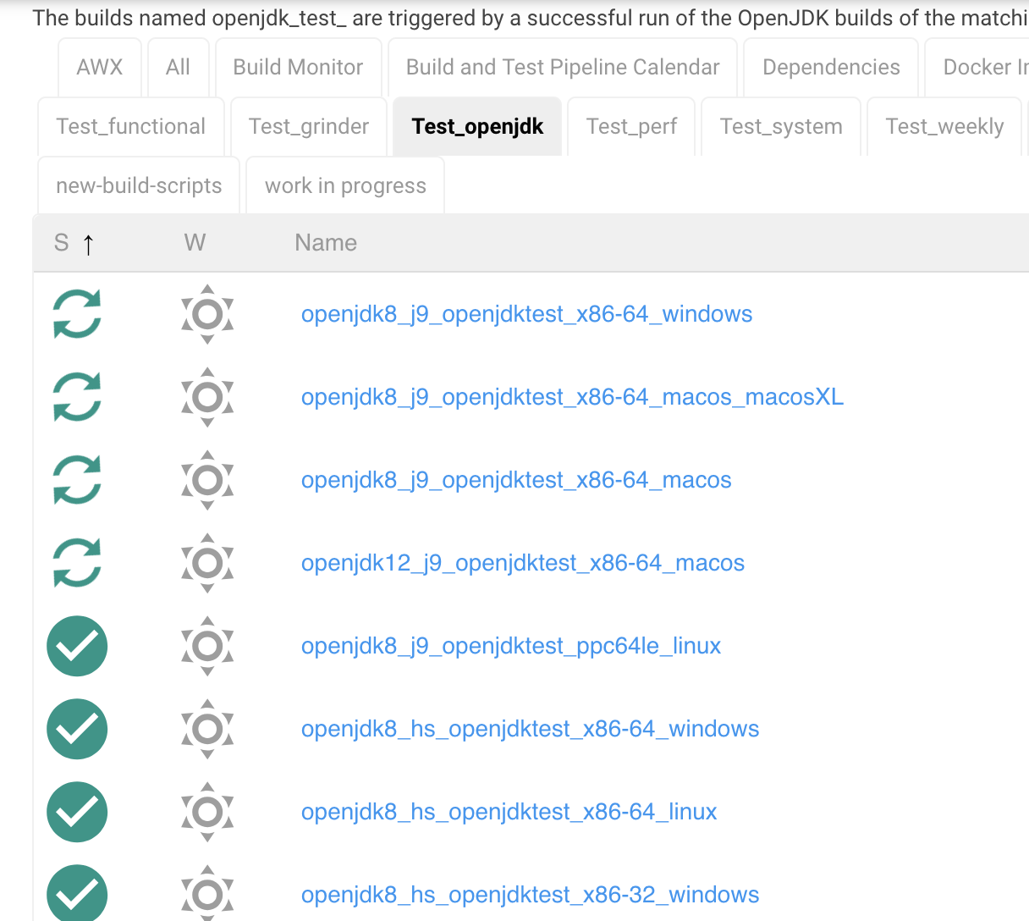
Survey of Tests: ci.adoptopenjdk.net
Dealing with Verification Data Overload
Categorize test builds based on JDK Version, JDK Impl, test category and platform

Slide 18
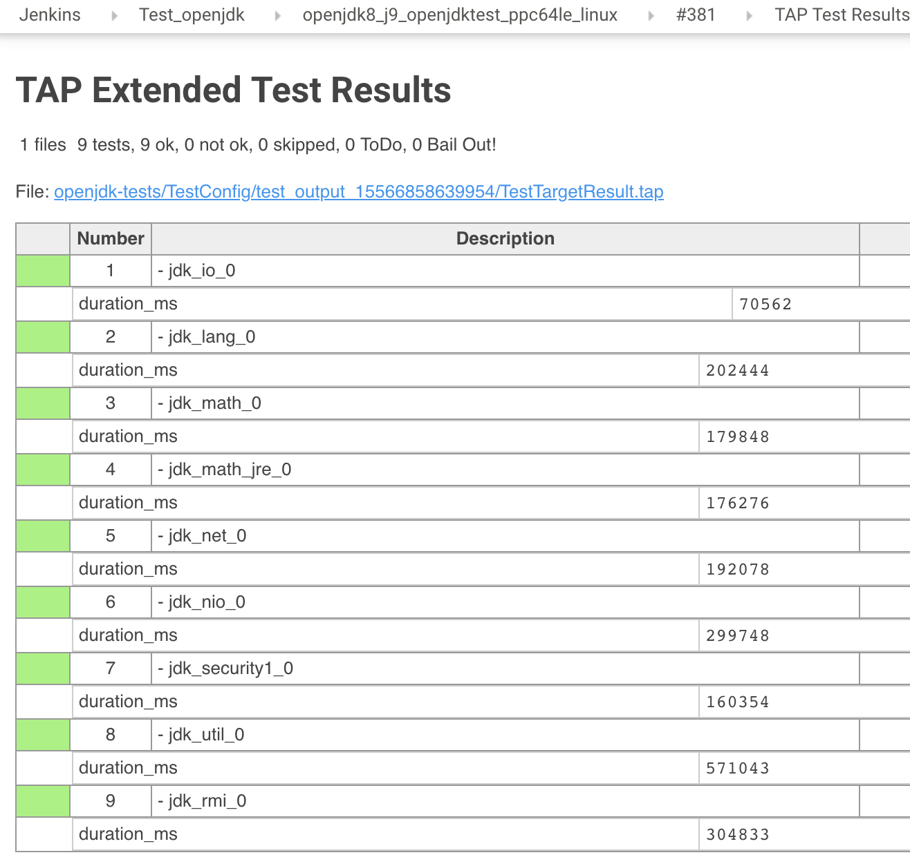
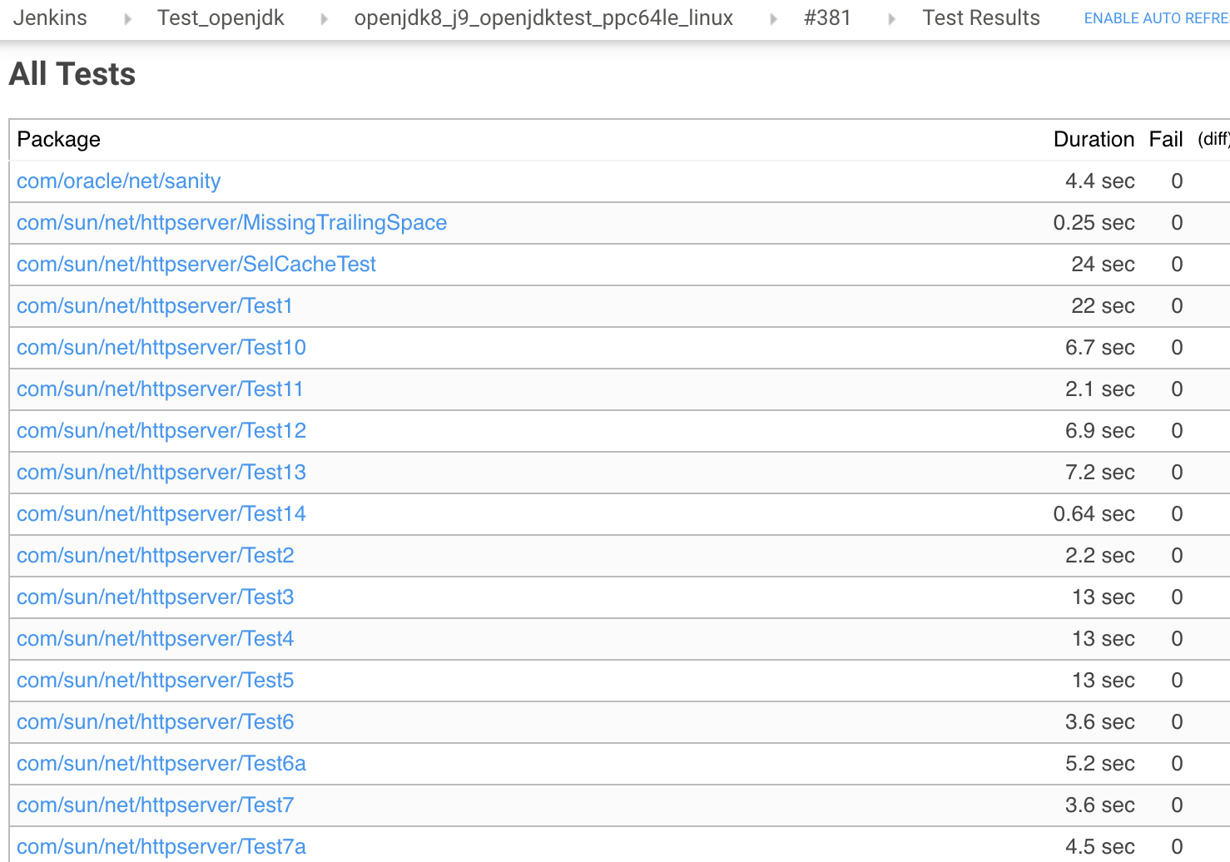
TAP & JUnit Plugin
Dealing with Verification Data Overload
Standardize output
Notes:
Leverage 3rd party Jenkins plugins

Slide 19
Archive data
Dealing with Verification Data Overload
Archive test data from failed tests onto Jenkins master or Artifactory:
Test logs/output files
Diagnostic files (core/trace/javacore files)
TAP file, JUnit *.jtr, *.xml files
Minimize stored artifacts
Notes:
Artifactory
open source project
binary repositories

Slide 20
Demo
Dealing with Verification Data Overload

Slide 21
Test Result Summary Service (TRSS)
Dealing with Verification Data Overload
Monitors multiple Jenkins servers
Personalized Dashboard
Provide filtering, sorting, comparing and searching feature
Provide history for triaging and performance trends
Available at https://trss.adoptopenjdk.net/
Git repo: https://github.com/AdoptOpenJDK/openjdk-test-tools

Slide 22
TRSS Overview
Dealing with Verification Data Overload
TRSS Server
Multiple Jenkins Servers
backend
backend
backend
Client
frontend
MongoDB

Slide 23
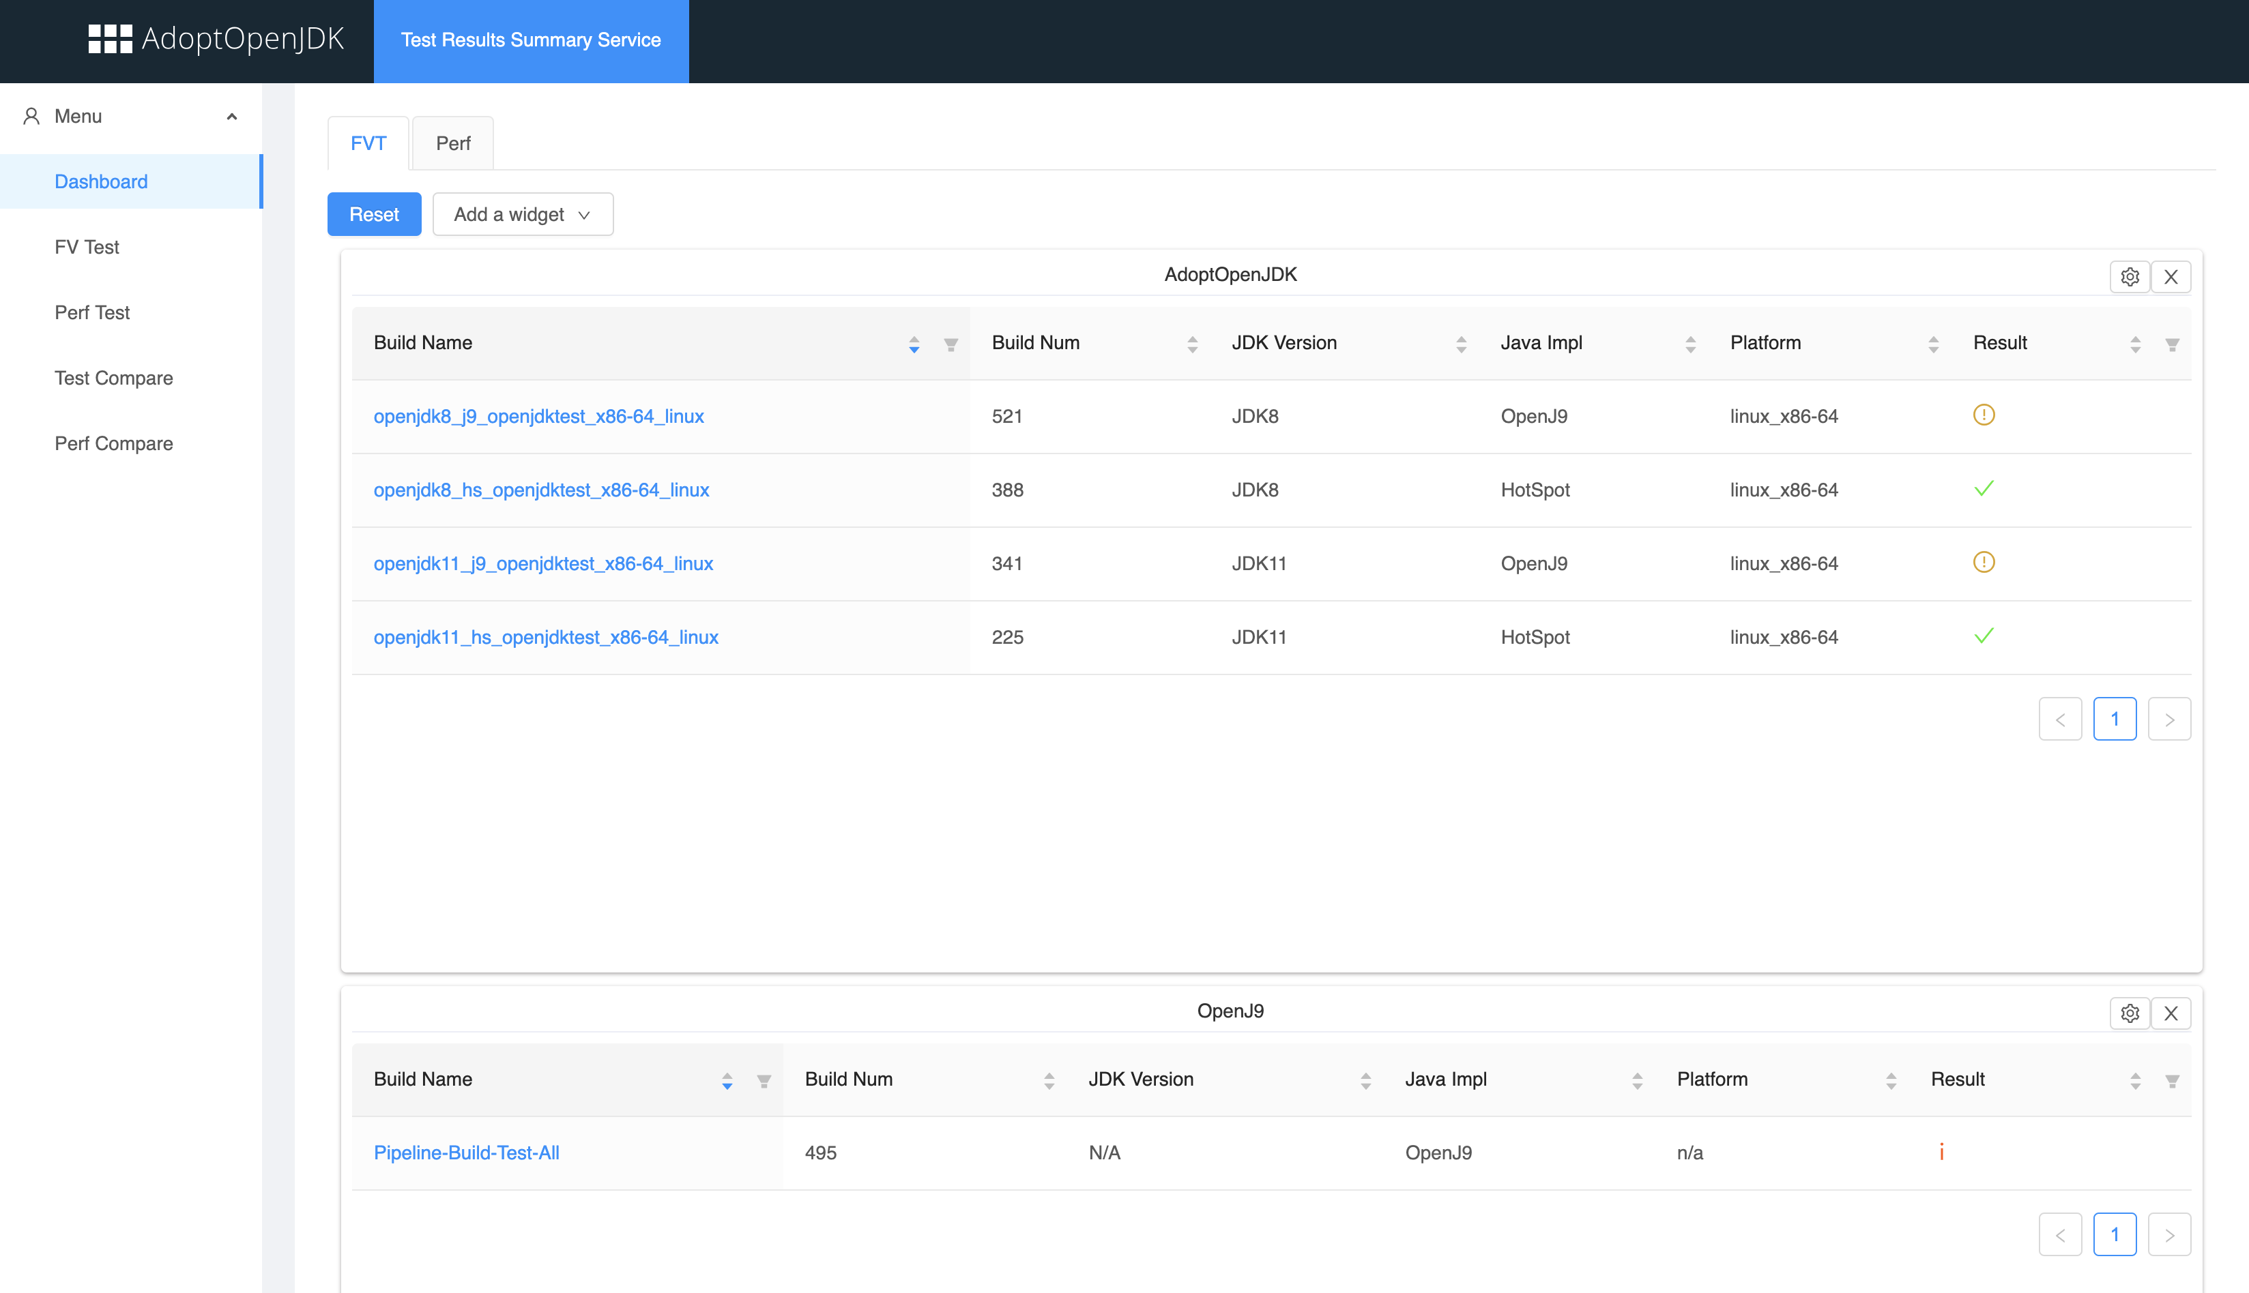
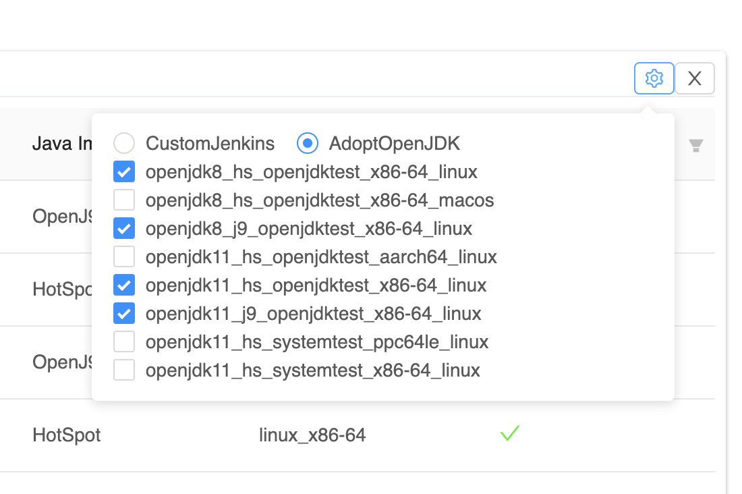
TRSS: Personalized Dashboard
Dealing with Verification Data Overload
Personalize views, only what you need

Slide 24
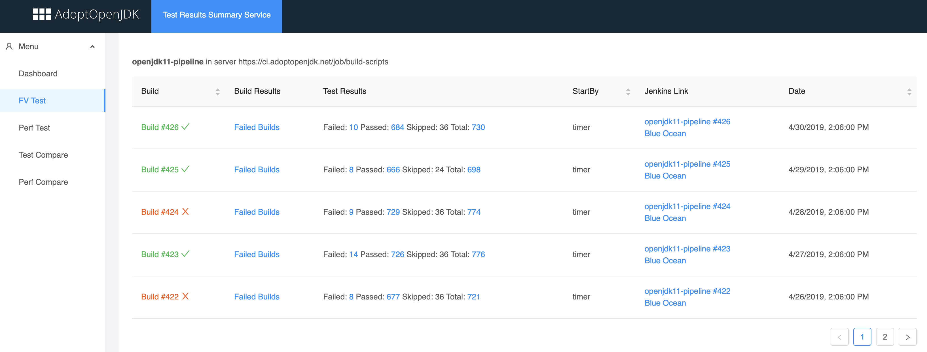
TRSS: Monitor Jenkins Pipeline Builds
Dealing with Verification Data Overload
Aggregate results from top-level pipelines

Slide 25
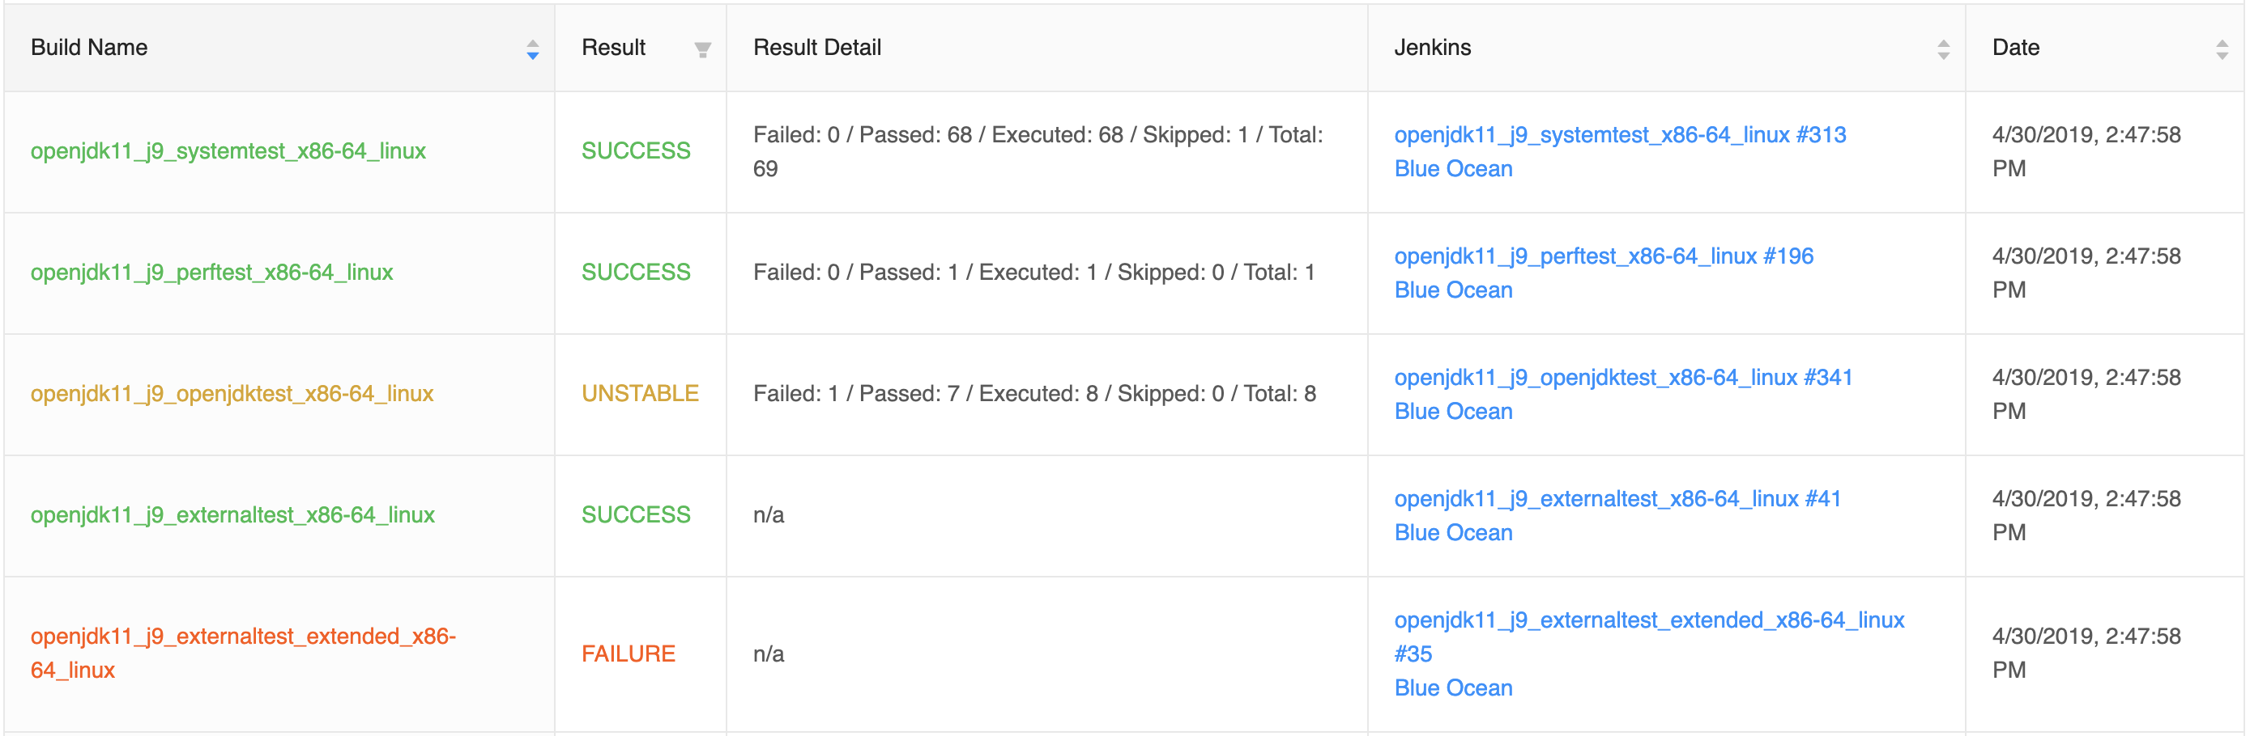
TRSS: Test Builds Result
Dealing with Verification Data Overload
Test Result Summary

Slide 26
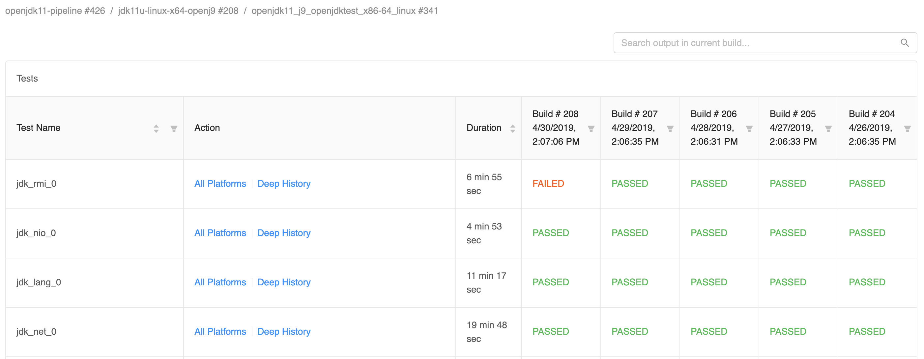
TRSS: Tests Result
Dealing with Verification Data Overload
Filter and sort on test name, duration, and test results

Slide 27
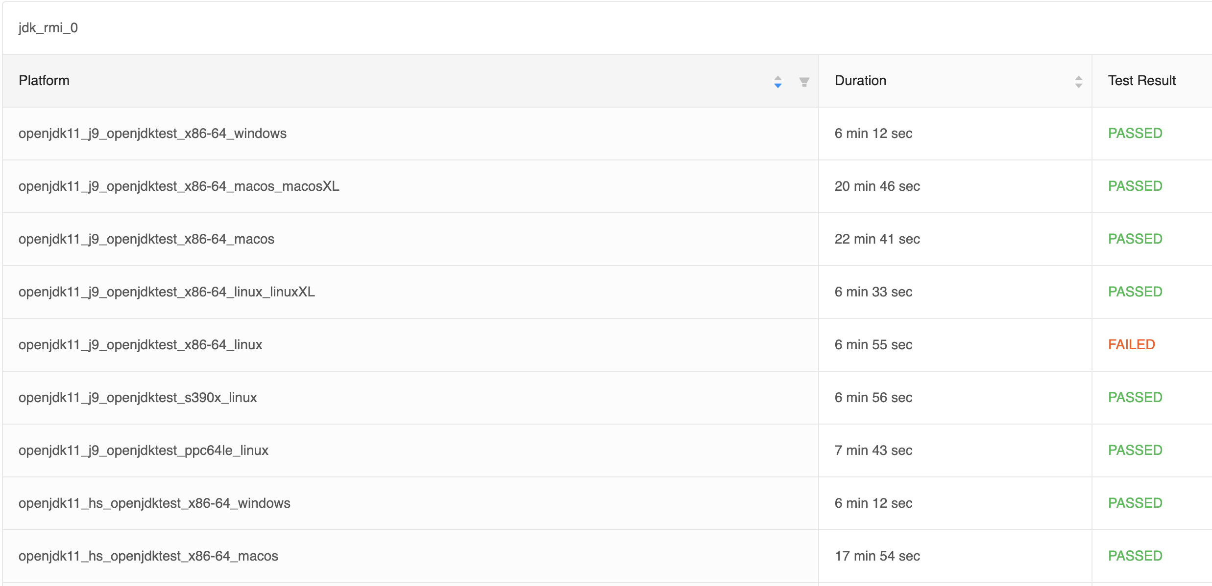
TRSS: Test result across all builds
Dealing with Verification Data Overload
Compare test results for all JDK impls, JDK versions and platforms

Slide 28
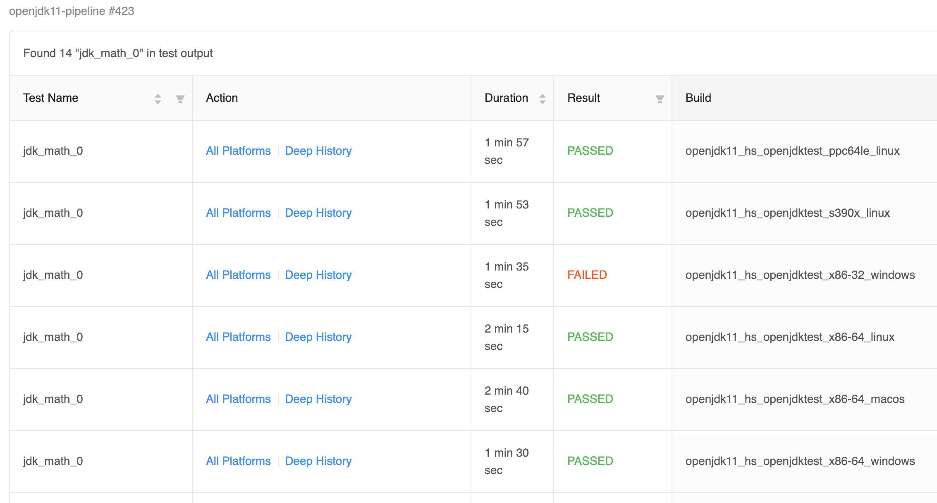
TRSS: Search test
Dealing with Verification Data Overload
Search test output among different test builds

Slide 29
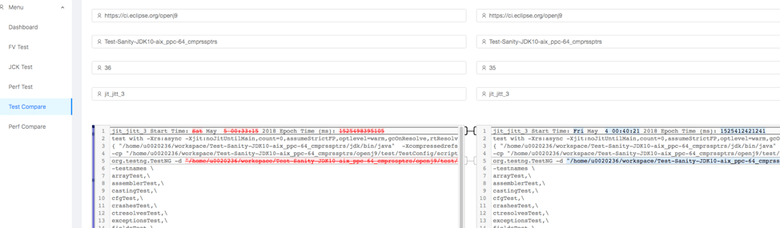
TRSS: Test Compare
Dealing with Verification Data Overload
Diff test results among two different builds

Slide 30
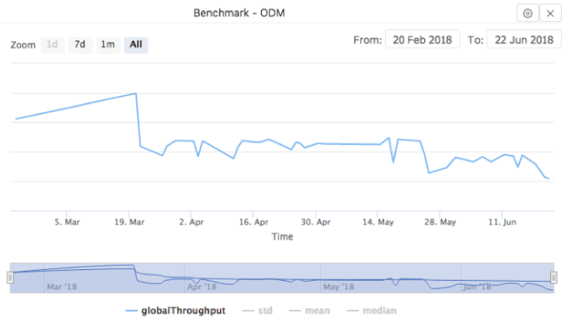
TRSS: Perf Dashboard
Dealing with Verification Data Overload
Visualize data graphically

Slide 31

Let Us Count the Ways
Dealing with Verification Data Overload
categorize
standardize
minimize
personalize
aggregate
summarize
filter
sort
compare
search
diff
visualize
model

Slide 32
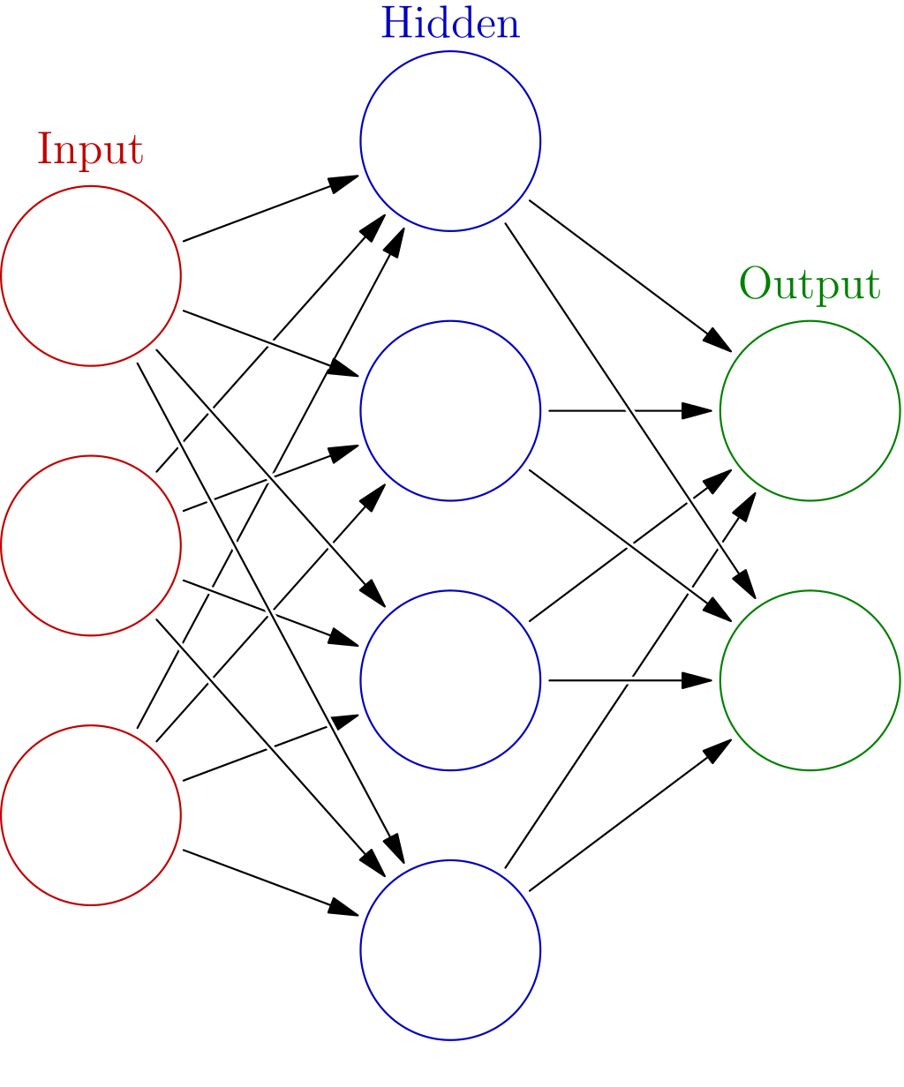
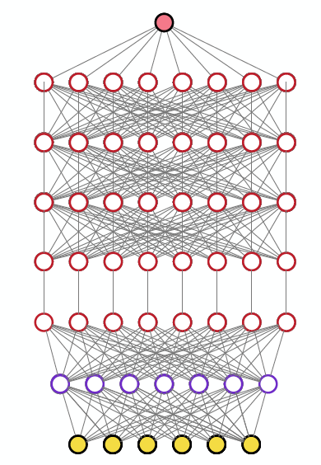
What is Deep Learning?
Dealing with Verification Data Overload
Deep learning is a subset of ML algorithms distinguished by:
Loosely based on structure and function of the brain, use artificial neural networks (ANN)
Multiple layers of processing units, “neurons”, output of a layer is input to another layer
Modes of learning, supervised (regression, classification) or unsupervised (pattern analysis)

Slide 33
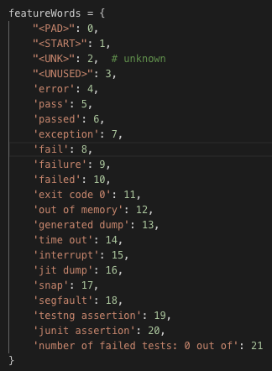
Initial DL Experiments
Dealing with Verification Data Overload
Preprocess testOutput based on own listed feature key words index.
Original testOutput:
“Running test TestIBMJlmLocal_0: ERROR code 3, FAILED test 1, running second test, exception ValueError, exit code 1”
Label: “FAILED”
Preprocessed testOutput:
“[4,
7,
10]”
Label:
“1”
Padding preprocessed testOutput for Deep Learning model:
“[4, 7, 10, 0, 0, 0, 0, 0, 0, 0, 0, 0, 0, 0, 0, 0, 0…]”
Label: “1”
Notes:
TensorFlow
Keras Sequential model
https://keras.io/models/sequential/
https://www.tensorflow.org/tutorials/keras

Slide 34
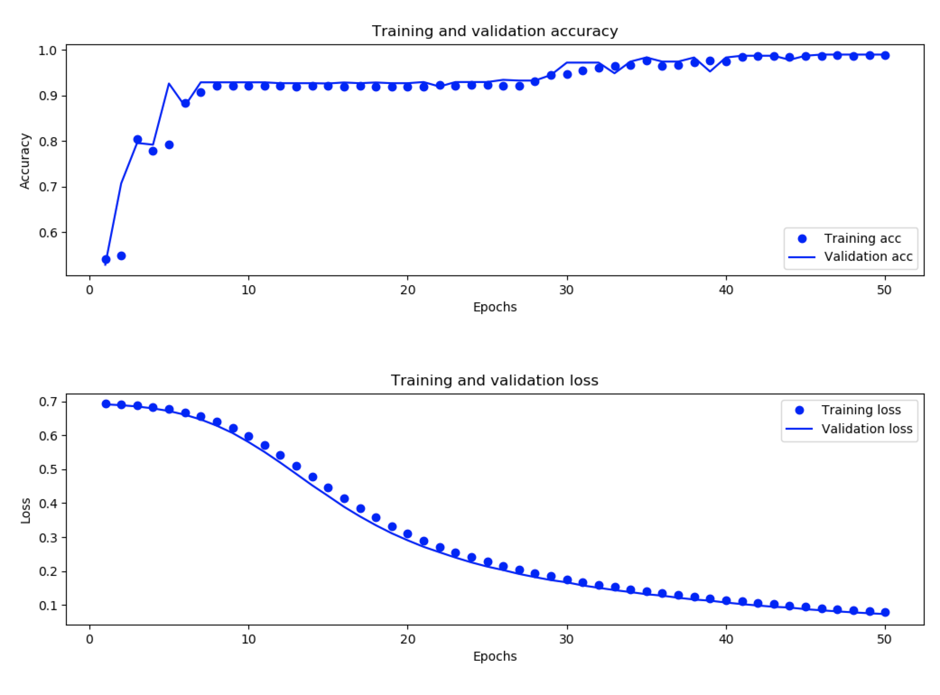
Initial DL Experiments
Dealing with Verification Data Overload
Training Accuracy and Validation Accuracy, our evaluation result is 98.897% with 7800 training data (3900 failed and 3900 passed) and 7800 test data
Training Loss and Validation Loss

Slide 35
Model Building
Dealing with Verification Data Overload
Things we know
(input layer)
Things we want to know
(output layer)
Variants used
Failure expression
Failure age
SHAs
Defect category
JVM version
Best next action
JVM Impl
Rate value of test
Platform
PR list
Bug prediction scores
Machine ‘age’

Slide 36
Lessons
Dealing with Verification Data Overload
Continue running. Use ‘scaffolding’ when necessary to never be broken (even when bringing in large changes)
Document everything before they ask
Keep it modular (Decouple test from compilation, plug in any JDK implementation, version, platform for testing)
Various levels of granularity for testing by tagging tests to provide greatest flexibility
Regular feedback from developers
Iterate to refine solutions (don’t settle)

Slide 37
Plans Forward
Dealing with Verification Data Overload
Test smarter (as test volume increases)
Change-based testing
Bug prediction service
Enhance TRSS with analytics services
Build skills and continue model/deploy, observe & measure
Innovate/Collaborate
AI-driven fuzz testing (with Professor Hugh Leather)
Test generation service (application of CTD)
Leverage & deploy useful models in open projects

Slide 38
Connect & Get Involved
Dealing with Verification Data Overload
Website Github Twitter Blog
adoptopenjdk.net AdoptOpenJDK/openjdk-tests @adoptopenjdk https://blog.adoptopenjdk.net/
AdoptOpenJDK
eclipse.org/openj9 eclipse/openj9 @openj9 https://blog.openj9.org/
eclipse.org/omr eclipse.org/omr @eclipseomr
https://eclipse-omr.org/blog/

Slide 39

Dealing with Verification Data Overload
Thank you
@bonjourlan
@rfw62891282
AdoptOpenJDK: https://adoptopenjdk.net/
Git repo:
https://github.com/AdoptOpenJDK/openjdk-tests
https://github.com/AdoptOpenJDK/openjdk-test-tools
https://github.com/eclipse/openj9

